Slide 1
Learning Transferrable Parameters for Long-tailed Sequential User Behavior Modeling
Year : 2020
Conference : KDD
Author : Yin Jianwen

Slide 2
Innovation
This paper proposes a gradient alignment optimizer and adopts an adversarial training scheme to facilitate knowledge transfer from the head to the tail.
This model can be directly adaptive to various well-established sequential model.

Slide 3
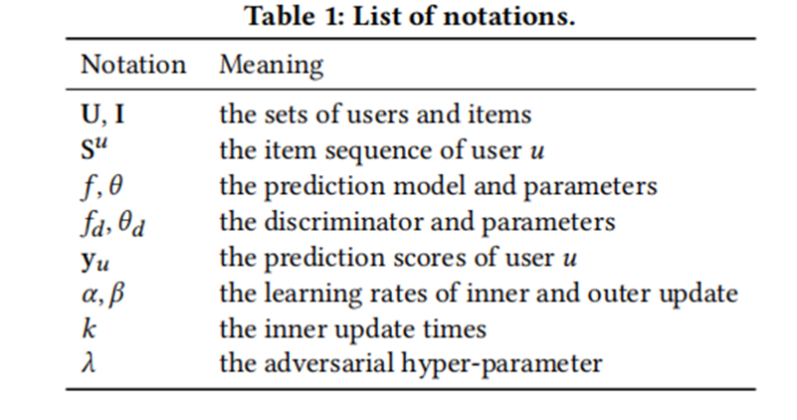





Problem Formulation
Input :
$U=${$u_{1},u_{2}$,…, $u_{|U|}$}
Users
$I=${$i_{1},i_{2}$,…, $i_{|I|}$}
Items
$S^{u}=${$S_{1}^{u},$ $S_{2}^{u}$,…, $S_{|S^{u}|}^{u}$}
Sessions
Objective :
$S^{(u,t)}=${$S_{t−L}^{u}$,$S_{t−L+1}^{u}$,…,$S_{t−1}^{u}$}
Latest L items of user u
$$y_{u}=f(S^{\left(u,t\right)};θ)$$
Scores for all items

Slide 4
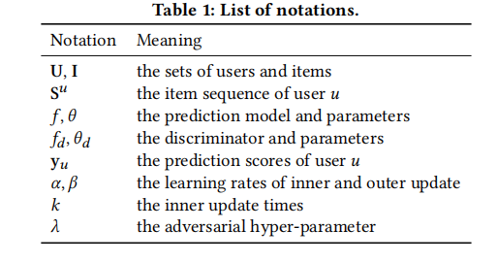


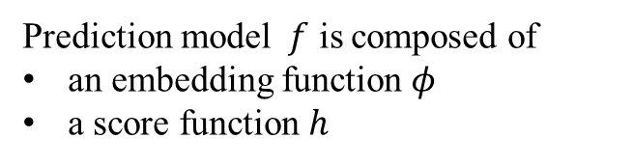
1. Base model
𝑓 (·) = ℎ(𝜙 (·))
Prediction model $f$ is composed of
an embedding function 𝜙
a score function $h$
Follows a negative sampling strategy

Slide 5


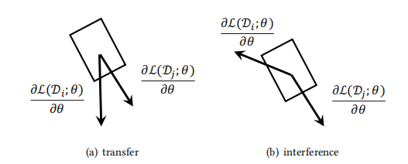
2. Gradient Alignment
Sample mini-batches $Di$ and $Dj$ from user $i$ and user $j$
Concept of transfer
Concept of interference

Slide 6
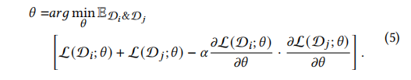
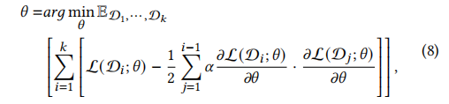


For every batch (i,j) pair
For k iterations
Substitution to reduce computation caused by second derivatives

Slide 7



3. Adversarial Training
Divide users into two parts : head users and tail users
R = 0 for tail and R = 1 for head
𝑓 (·) = ℎ(𝜙 (·))
Prediction model $f$ is composed of
an embedding function 𝜙
a score function $h$
𝜙 is the generator and $f_{d}$ is the discriminator
In this way, the bias caused by the large amount of data from head users could be reduced, thus facilitating knowledge transfer from the head to the tail.

Slide 8
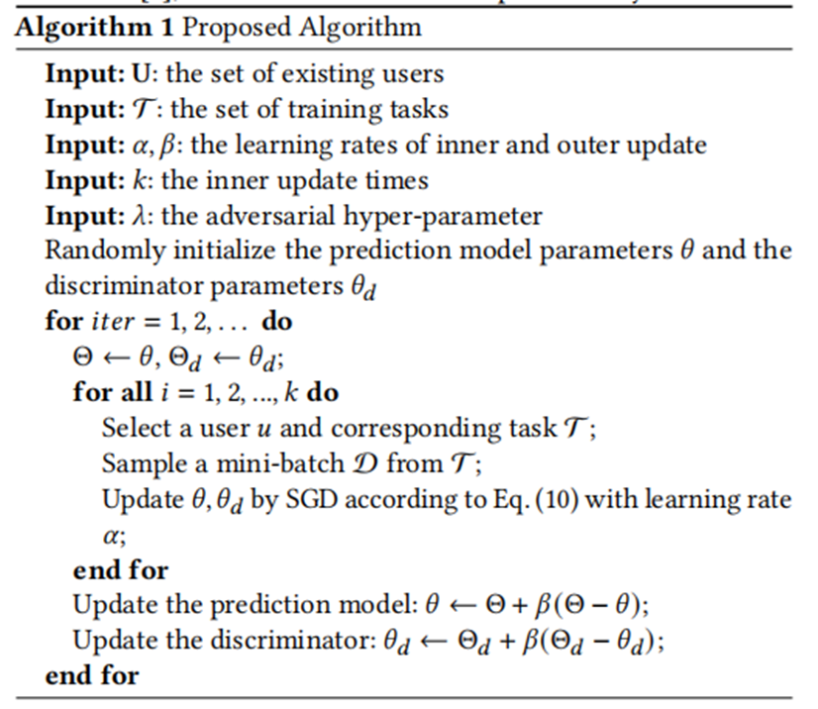
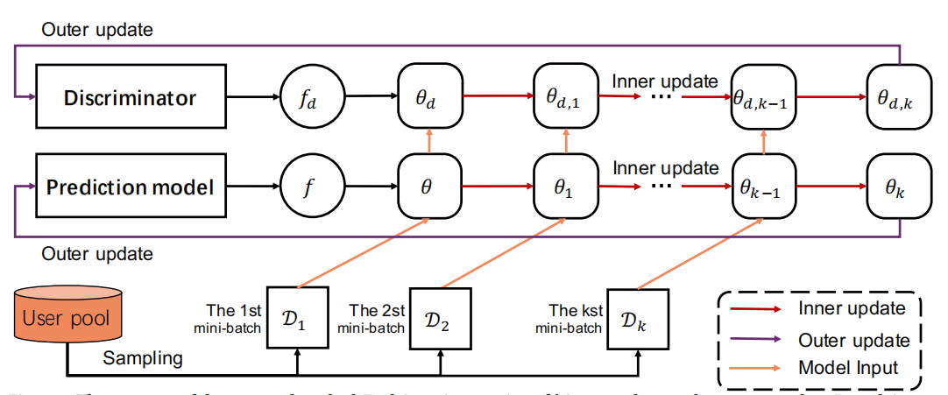
4. Proposed Algorithm

